Slide 1
Role of social media in fighting crime
(Student’s Name)
Course Number
Professor’s Name

Slide 2
SMARTPHONES
a mobile phone with a touchscreen interface, internet access, and an operating system capable of running downloaded applications that performs many of the functions of a computer.
Mobile phones are majorly used for communication, usually by calls or text messages.
Smartphones are an advanced version of mobile phones, with a wider range of uses.

Slide 3
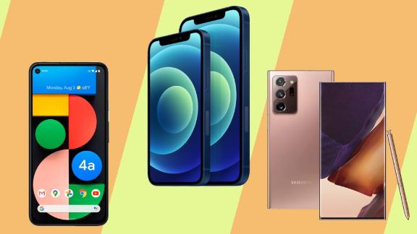

Slide 4
Smartphones are used for:
sending and receiving emails
Video sharing
Video conferencing
Playing games
Barcode scanning
Taking and sharing photos
Showing map of user's location by Global Positioning System (GPS)

Slide 5
Registering contacts
Calculator, currency and clock functions
Torch
Browsing the internet
Taking and searching notes
Mobile payments for goods and services
MP3 player and sound recording

Slide 6
How smartphones aid in fighting crime
High quality images taken by smartphones make face recognition easier for the authorities to identify the suspects, or victims.
Sharing of information (documents or images) throughout the National criminal justice system is made easier by the smartphones.
The messages, emails, phone calls or text messages on smartphones can help build a profile about a suspect.

Slide 7
Global Positioning system in smartphones can help the authorities to trace a criminal, since most people carry their smartphones everywhere.
Mobile payment methods can help trace the location of a criminal by tracking their last purchasing location.
Citizens can also record incriminating conversations of a suspicious act.
Video footage of an ongoing crime can also be used as evidence to put away criminals.

Slide 8
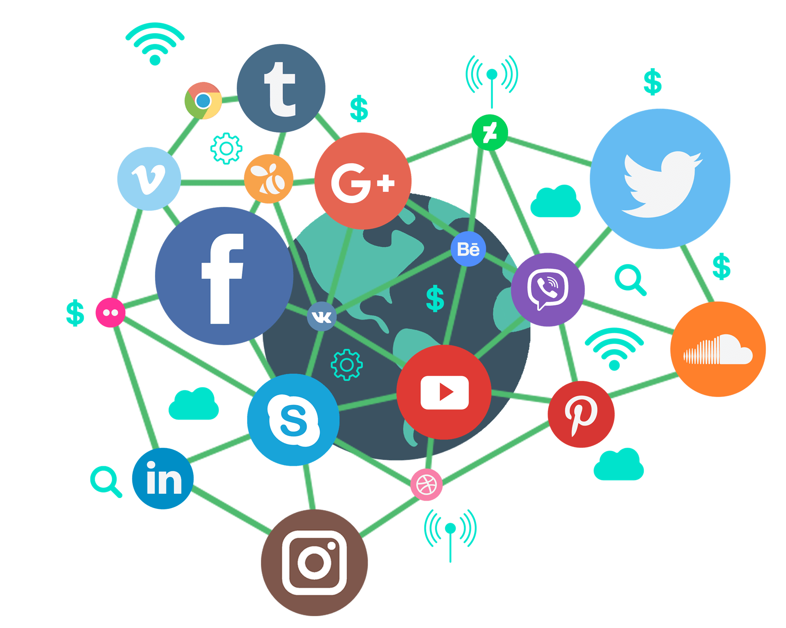

Slide 9
Role of social media in the criminal justice system
Images, videos and recordings posted on social media can be used as evidence for a certain crime.
Police agencies use social media for:
Reaching out to the public about safety concerns.
Engaging citizens/community outreach.
Reputation management/public relations and notifying the public about non-criminal issues, like traffic.

Slide 10
Social media presence of local law enforcement
The police frequently keep up with communications with the public:
They may post a photo of a missing person on their website or other platforms like twitter, to ask the public for any information regarding the victim.
They also, may inform the public about a wanted suspect via the platforms, so they can be flashed out.
The law enforcement also inform the public of any arrest of a criminal they were previously asked to look out for.

Slide 11
Future of social media in the criminal justice system
Social media continues to have a great influence among various fileds, including the criminal justice system.
The main role of the criminal justice system being to catch criminals, the impact of social media in the process cannot be igmored.
However, some evidence according to some courts is inadmissible, which some criminals use as loophole to escape prison.
The laws regarding use of social media as a source of evidence should be reviewed, so there’s nowhere to hide for criminals.
Also, crimes like cyberbullying have not been there since the beginning of time, and should be looked at carefully to ensure citizens’ safety.

Slide 12
References
https://www.cnn.com/2020/12/31/cnn-underscored/best-smartphones-2020/index.html
Andriotis, P., Oikonomou, G., & Tryfonas, T. (2012, December). Forensic analysis of wireless networking evidence of android smartphones. In 2012 IEEE International Workshop on Information Forensics and Security (WIFS) (pp. 109-114). IEEE.
https://www.google.com/search?q=social+media&tbm=isch&source=iu&ictx=1&fir=b1Qt2W51Cwwm9M%252CoKDCxaQvo7tk8M%252C_&vet=1&usg=AI4_-kQ1hIK4daGYBB_cZFIyoB5oUh4mKQ&sa=X&ved=2ahUKEwjd6-mcmMTvAhV7FVkFHSk1CDgQ_h16BAgHEAE#imgrc=7fCq60iGvoqwFM
Jeanis, M. N., Muniz, C. N., & Molbert, C. L. (2019). Law enforcement and social media usage: An analysis of engagement. Policing: A Journal of Policy and Practice.

